Slide 1


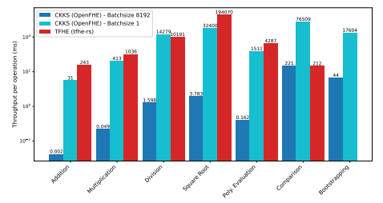
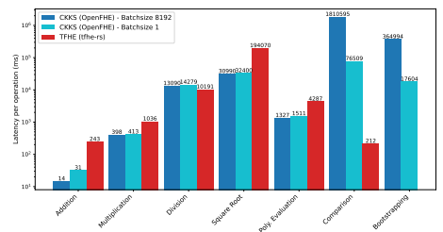
FHE: Encryption through Scheme Switching
Brandon Angell, Jude Skrzat, Ethan Temple, Brian Shepard
Advisor: Dr. Lei Xu
Abstract
Fully Homomorphic Encryption (FHE) offers a paradigm shift in data privacy by enabling complex computations directly on encrypted data, allowing untrusted cloud environments to process sensitive information securely. However, the practical adoption of FHE is heavily hindered by the algorithmic constraints of individual cryptographic schemes.
Arithmetic schemes, such as CKKS, excel at efficient, large-scale linear mathematics but struggle with non-linear logic and exact comparisons. Conversely, boolean schemes like TFHE and FHEW perfectly execute logical operations and thresholding but suffer from extreme latency when performing statistical math.This project explores "Scheme Switching," a breakthrough cryptographic protocol that bridges this gap by transforming ciphertexts between arithmetic and boolean schemes mid-computation without requiring decryption. Utilizing the OpenFHE library, we demonstrate a hybrid computational pipeline through a Secure Threshold Alert System. In this architecture, encrypted sensor data is first aggregated and averaged using the computationally efficient CKKS scheme. The resulting ciphertext is then seamlessly switched into the FHEW scheme to evaluate a precise non-linear threshold comparison, simulating a privacy-preserving smart thermostat or medical triage alert. By actively managing the cryptographic noise and latency trade-offs inherent in the switch, scheme switching successfully resolves the FHE non-linearity bottleneck.
This hybrid approach effectively combines the computational speed of arithmetic schemes with the exact precision of boolean schemes, unlocking viable pathways for advanced, privacy-preserving applications in machine learning, finance, and secure IoT networks.
Pros of CKKS Cons of CKKS Pros of FHEW Cons of FHEW
Fast vector arithmetic
Handles real numbers natively
SIMD-style slot packing
Great for ML / statistics
Approximate results
No comparisons/branching
Complex depth management
Exact computation
Native comparisons
Fast bootstrapping
No slot packing
Poor floating-point
Slow for large math
CKKS to FHEW
Scale
  CKKS works with approximate numbers. FHEW works with numbers mod p
Round
  Convert scaled floats to integers
Modulus Switch
  CKKS uses large mod Q, FHEW uses small mod p
Extract
  Smaller p means faster, but more error
FHEW to CKKS
Collect
  FHEW ciphertext are individual, CKKS are grouped
Map
  Use a linear transformation matrix to construct the CKKS slots
Chebyshev Approximation
  Approximate the modular reduction
Scale Back
  Divide by original scale
CKKS vs TFHE Performance Results
Throughput of all benchmarked operations (milliseconds) vs Latency of all benchmarked operations (milliseconds)
What is scheme switching?
FHE relies on taking data and converting it into “ciphertext” that has been encoded so that it is unreadable but able to be operated on by the scheme that has encoded it. However, schemes are very specialized with limited use cases. Switching between schemes would require a full decryption of ciphertext and reencryption into the new scheme’s specific pattern, which is costly and slow.
Scheme switching aims to mitigate this problem by converting from one scheme’s ciphertext to another’s without ever decrypting the original data, saving time and allowing for a much more versatile multi-scheme structure.
Citations
Krüger, Clemens, et al. A Performance Comparison of the Homomorphic Encryption Schemes CKKS and TFHE, eprint.iacr.org/2025/1460.pdf. Accessed 12 Apr. 2026.
Applications section? Use cases etc.
Healthcare monitoring: Averaging results and checking against thresholds while protecting sensitive medical info Smart Home systems: Processing secure data like energy and temperature and responding as needed Private databases: User data, poll results, or signalling can all be accessed and dynamically acted on without viewing any of the raw data

